Slide 1
Hot Legal Topics Affecting Condo-Hotels and Onsite Property Managers
Daniel F. Benavides, Esq.
Daniel J. Barsky, Esq.
Shutts & Bowen LLP

Slide 2

Cybersecurity and Data Privacy
The General Data Protection Regulation, a/k/a
(Approximately 800 pounds…)

Slide 3
The General Data Protection Regulation (GDPR)
What is it?
  European Union Regulation
  Introduced 2012
  Adopted 2016
  Effective MAY 25, 2018
  Regulates ‘processing’ of ‘personal data’ (“PD”) (those are defined terms in the regulation).
  Includes the collection, use, transfer, monitoring, tracking, and viewing(!!) of personal data.

Slide 4
The General Data Protection Regulation (GDPR)
So, it’s an EU regulation…what’s the big deal?
  Rights follow EU citizens around the world.
  UK is following suit with Data Protection Bill that will align with GDPR, so Brexit is a non-issue.
  This means…
    If you have a physical presence in the EU; or
    If you do business in the EU; or
    If you collect personal data from EU residents; or
    You’re open to business from EU residents…
    GDPR DOES OR MAY APPLY TO YOU!

Slide 5
The General Data Protection Regulation (GDPR)
Why should you care?
GDPR probably applies to you if you have international guests.
Violation = up to €20 million or 4% of the worldwide annual revenue of the prior financial year, whichever is higher.
The EU is not messing around!!!

Slide 6
The General Data Protection Regulation (GDPR)
Is fundamentally different from any other digital privacy law currently in existence.
  Covers ‘personal data’ or ‘personal information’, which includes.
  Compare to US standards of ‘personally identifiable information’ (“PII”).
  PII is much narrower…

Slide 7
The General Data Protection Regulation (GDPR)
“Personal Data” | “Personally Identifiable Information”
any information relating to a person, including names, email addresses, social media posts, IP addresses (even dynamic IP addresses), pseudonyms/handles, and cookies because they can be traced to a person and combined with other data to identify a specific person | information about an individual, including names and email addresses, but excludes IP addresses and cookies since they cannot be used to identify a specific person on their own
GDPR COVERS MUCH MORE DATA!

Slide 8
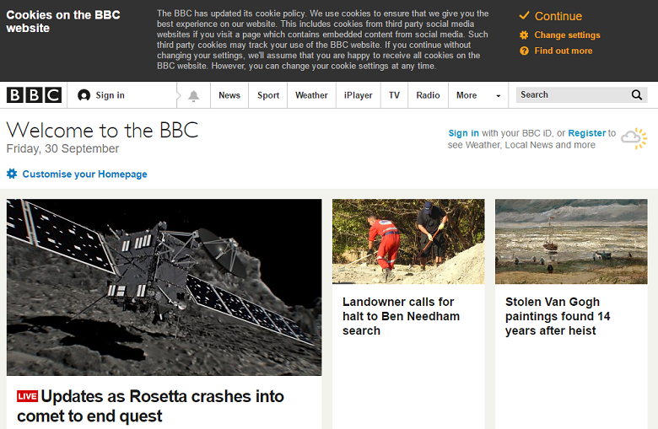
The General Data Protection Regulation (GDPR)
GDPR is different from (but related to) the “Cookie Law”…

Slide 9
The General Data Protection Regulation (GDPR)
How broad is GDPR? “Processing of Data” (a touchstone of applicability) includes:
Collection. Recording. Organization. Structuring. Storage. Adaptation or alteration. Retrieval. Consultation. Use. | Disclosure by transmission. Dissemination or otherwise making available. Alignment or combination. Restriction (that is, the marking of stored data with the aim of limiting its processing in the future). Erasure. Destruction.

Slide 10
The General Data Protection Regulation (GDPR)
Seven ‘data protection principles’ at the heart of GDPR:
  Lawfulness, fairness, and transparency (in relation to the data subject). Exactly what it sounds like.
  Purpose limitation. Must be collected only for specified, explicit, and legitimate purposes.
  Data minimization. Must be adequate, relevant, and limited to what is necessary in relation to the purpose for which it is processed.
  Accuracy. Data that is inaccurate with regard to the purposes for which it is processed must be erased or rectified without delay.

Slide 11
The General Data Protection Regulation (GDPR)
  Storage Limitation. PD must not be kept in a form which permits identification of data subjects for longer than necessary for the purposes for which the data is processed.
  Integrity and Confidentiality. PD must be processed in a manner that ensures security, including protection against unauthorized or unlawful processing and against accidental loss, destruction, or damage.
  Accountability. Data controller must be able to demonstrate compliance.

Slide 12
The General Data Protection Regulation (GDPR)
GDPR magnifies a pre-existing business tension:
  You want to collect information on your guests for a number of reasons:
    Marketing and Promotions
    Enhancing experience
    Intercepting problems (being proactive) to prevent negative reviews
    Internal analytics and modeling
  But, collecting and utilizing this comes with liability:
    Data breach
    GDPR

Slide 13
The General Data Protection Regulation (GDPR)
Because the data is valuable, we cannot throw the baby out with the bathwater.
Only options are:
  Segregate data between EU and non-EU subjects and create parallel systems (difficult to do, costly); or
  Refuse all EU customers (bad business and probably illegal); or
  Comply with GDPR.

Slide 14
Complying with the GDPR
The GDPR defines consent as a (1) freely given, (2) specific, (3) informed, and (4) unambiguous indication of the data subject's wishes by which he or she, by a statement or by a clear affirmative action, signifies agreement to the processing of his or her personal data.
A statement can include a written statement (including by electronic means) or an oral statement.
Examples of affirmative actions include:
  Ticking a box when visiting a website.
  Choosing technical settings for an online service.
  Any other conduct which clearly indicates in this context the data subject's acceptance of the proposed processing of their personal data.

Slide 15
Complying with the GDPR
Silence, pre-ticked boxes or inactivity should not normally constitute consent. When the processing has multiple purposes, consent should be given for all of them.
The data controller must be able to demonstrate that "the data subject has consented to processing of his or her personal data." For consent to be informed, the data subject should be aware of at least the data controller's identity and the intended purposes of the processing.

Slide 16
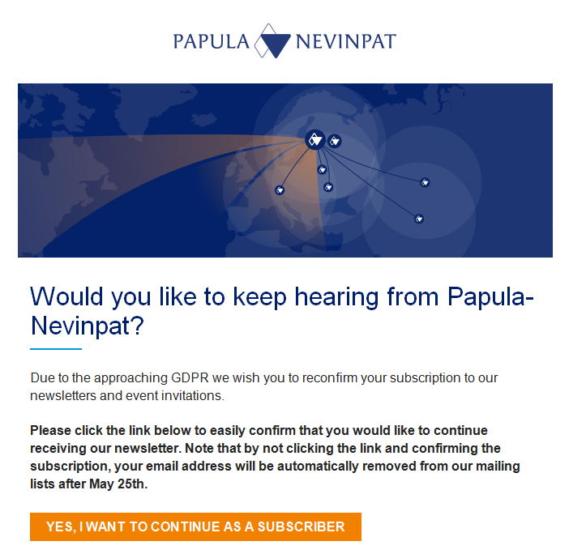
Complying with the GDPR – Some Examples
Who here has received one of these emails?

Slide 17
Complying with the GDPR – Some Examples
Guest registration cards…
Name |  |  |  | Room Number
Company |  |  |  | Room Type
Address |  |  |  | Arrival Date
 |  |  |  | Departure Date
 |  |  |  | Total Nights
City |  | Postal Code |  | Adults
State (Prov.) |  |  |  | Children
E-mail |  |  |  | Source
Telephone |  |  |  | Deposit
Confirmation Number |  |  |  | Payment type
Daily Rate
Total Rate
Parking: | No ______ | Yes ______ | ($_______ USD/Day Tax Inclusive Overnight Charge)
By signing below, I hereby agree to be held personally liable for all costs and charges relating to the above-referenced reservation including, without limitation, the total room rate and any incidental charges (collectively, “Charges”). I further agree to be held personally liable and fully indemnify _________________ for any and all claims, demands, damages, liabilities, expenses, losses of every nature and kind (including reasonable attorneys’ fees) (collectively, “Claims”) arising out of my intentional or negligent acts and/or the intentional or negligent acts or omissions of my guests or invitees. I hereby authorize the hotel and/or its affiliates to charge the credit or debit card on file with the hotel for any and all Charges and/or Claims, and I certify that I am an authorized user of such credit or debit card and will not dispute any Charges or Claims with my bank or credit card company. Notice to Debit Card Users: By submitting your debit card as a method of payment you are authorizing an approval to be secured on your checking account. The amount of the approval will be deducted from your checking account and reduce your available balance.
I understand and agree that money, jewelry and other valuables brought to the hotel are at the guest’s sole risk, and that the hotel shall not be responsible for any loss or damage thereto. This is a non-smoking hotel. Smoking is only permitted in designated open areas. In case of smoking indoors, I understand and agree that the hotel may charge my debit or credit card a minimum fee of $_________ daily for deep cleaning. No plug-in appliances or equipment are permitted on the balconies and must remain indoors at all times. The use of extension cords is strictly prohibited.
I have read and understand all terms and conditions described above and agree to comply with the foregoing terms and conditions and all other hotel rules and regulations applicable to guests.
Guest Signature ___________________________________________________ Print Name: _______________________________________ Date:

Slide 18
Complying with the GDPR – Some Examples
Add language…
“I hereby acknowledge receiving a copy of the Hotel’s Data and Privacy Policies and DO □ or DO NOT □ consent to the processing of my personal data for the following purposes: [list each purpose separately].”

Slide 19
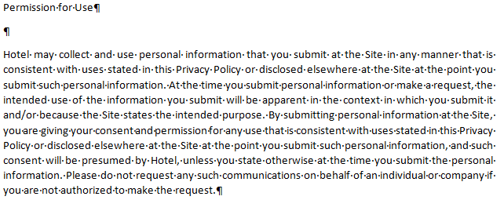
Complying with the GDPR – Some Examples
Update websites with lightboxes/popups for compliance.
Also, update website privacy policy which should be separate from terms and conditions.

Slide 20
Complying with the GDPR – Some Examples
General permission and ‘bundled’ permission are not GDPR compliant.
“Information We Collect About You and How We Collect It. We collect several types of information from and about users of our Website, including information:
  by which you may be personally identified, such as name, postal address, e-mail address, telephone number,[ social security number][ or [ANY OTHER INFORMATION THE WEBSITE COLLECTS THAT IS DEFINED AS PERSONAL OR PERSONALLY IDENTIFIABLE INFORMATION UNDER AN APPLICABLE LAW]/any other identifier by which you may be contacted online or offline] ("personal information");
  that is about you but individually does not identify you, such as [SPECIFY TYPES OF INFORMATION]; and/or
  about your internet connection, the equipment you use to access our Website and usage details.
“We collect this information:
  Directly from you when you provide it to us.
  Automatically as you navigate through the site. Information collected automatically may include usage details, IP addresses, and information collected through cookies[, web beacons,] [and other tracking technologies][include separate provisions for each].
  [From third parties, for example, our business partners.]

Slide 21
Complying with the GDPR – Some Examples
“How We Use Your Information. We use information that we collect about you or that you provide to us, including any personal information:
  To present our Website and its contents to you.
  To provide you with information, products, or services that you request from us.
  To fulfill any other purpose for which you provide it.
  [To provide you with notices about your [account/subscription], including expiration and renewal notices.]
  To carry out our obligations and enforce our rights arising from any contracts entered into between you and us, including for billing and collection.
  To notify you about changes to our Website or any products or services we offer or provide though it.
  [To allow you to participate in interactive features on our Website.]
  [DESCRIBE ANY OTHER USES]
  In any other way we may describe when you provide the information.
  For any other purpose with your consent.
“[We may also use your information to contact you about [our own and third-parties'] goods and services that may be of interest to you. If you do not want us to use your information in this way, please [check the relevant box located on the form on which we collect your data (the [order form/registration form])/adjust your user preferences in your account profile.] For more information, see Choices About How We Use and Disclose Your Information.
“We may use the information we have collected from you to enable us to display advertisements to our advertisers' target audiences. Even though we do not disclose your personal information for these purposes without your consent, if you click on or otherwise interact with an advertisement, the advertiser may assume that you meet its target criteria.]

Slide 22
The General Data Protection Regulation (GDPR)
This is just a brief overview of GDPR.
The regulations and requirements are far more complex (and onerous).
There is no ‘one size fits all’ solution as each company (and even each property within a company) processes personal data differently and for different purposes.

